Slide 1
Convolutional to Neural Network
Mohammad Akhavan Anvari

Slide 2
Problem of MLP
Consider the ImageNet datasets:
100 pixel * 100 pixel = 100,000
If you set architecture:
Input: 100,000
L1: 10,000
L2: 1000
Weights: 10^5 * 10^4 + 10^4 * 10^3 = 10^9 + 10^7 = 1,001,000,000

Slide 3
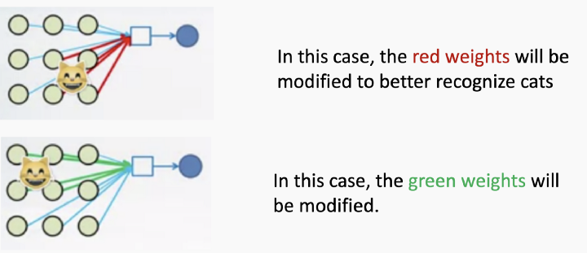
Problem of MLP
Control over the feature space

Slide 4
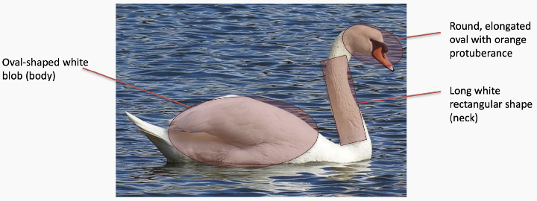
What is Feature

Slide 5
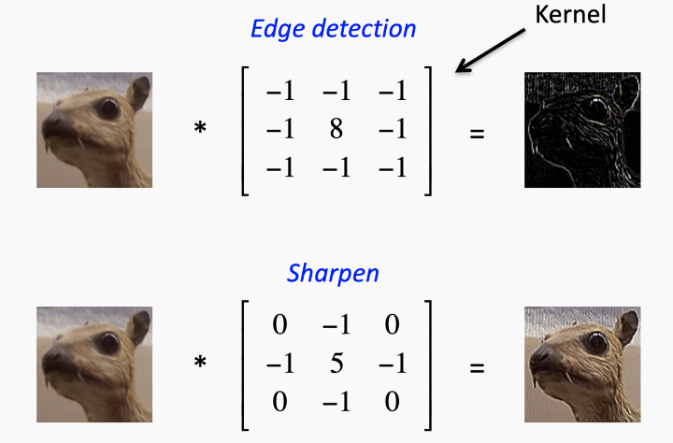
How to Extract Features

Slide 6
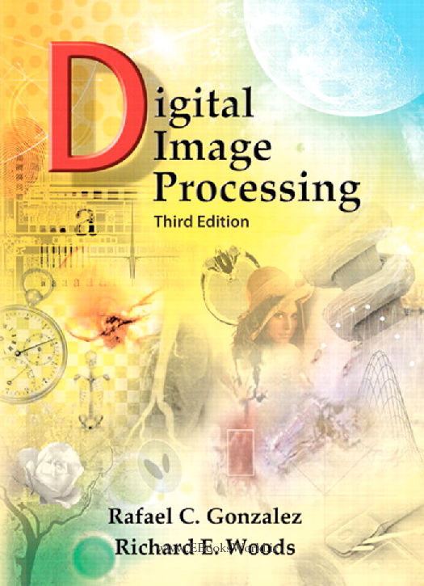
For More

Slide 7
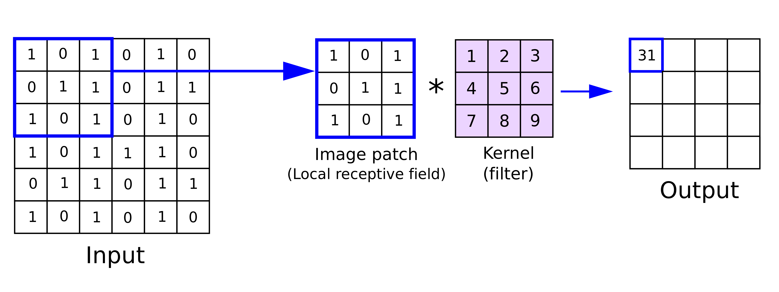
Convolution Filter

Slide 8
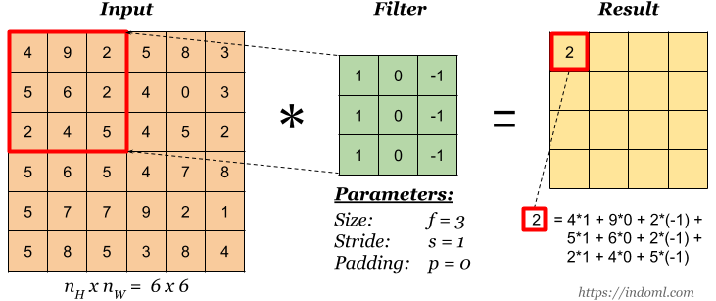
Convolution Filter

Slide 9
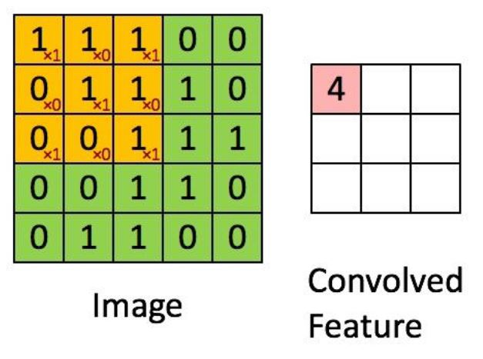
Convolving the Filter

Slide 10
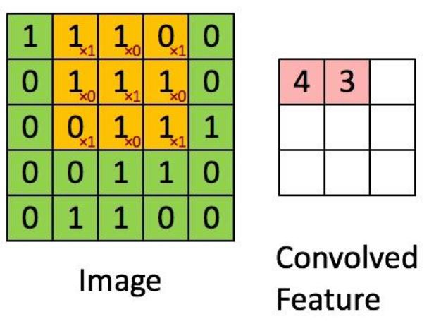
Convolving the Filter

Slide 11

Convolving the Filter

Slide 12
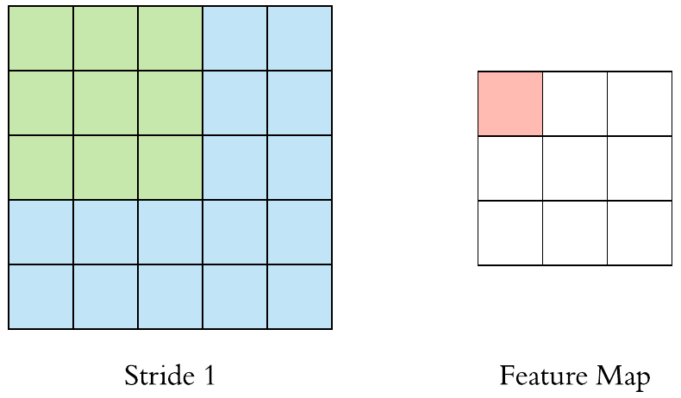
Stride

Slide 13
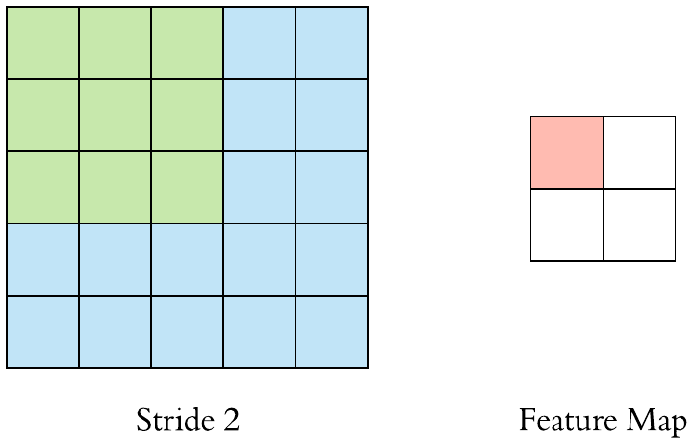
Stride

Slide 14
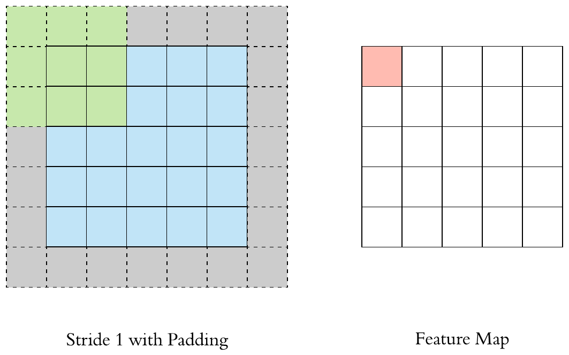
Padding

Slide 15
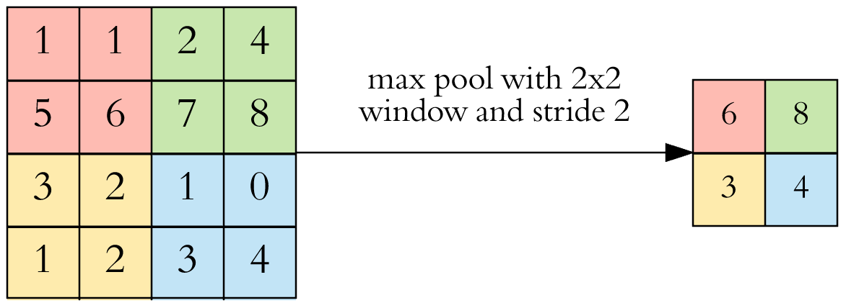
Pooling

Slide 16
Pooling
Max Pooling
Average Pooling
Min Pooling

Slide 17
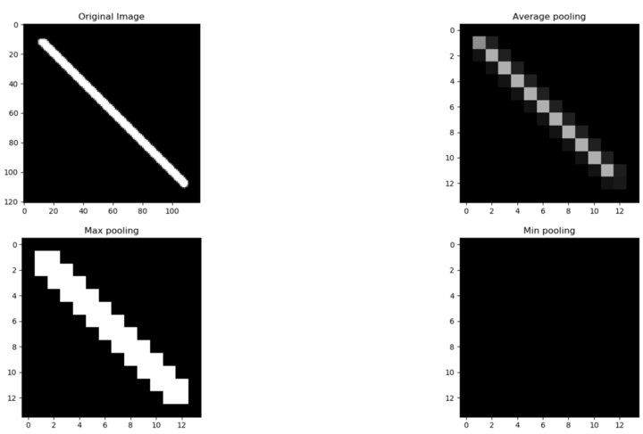
Pooling

Slide 18

CNN 3 Channel

Slide 19
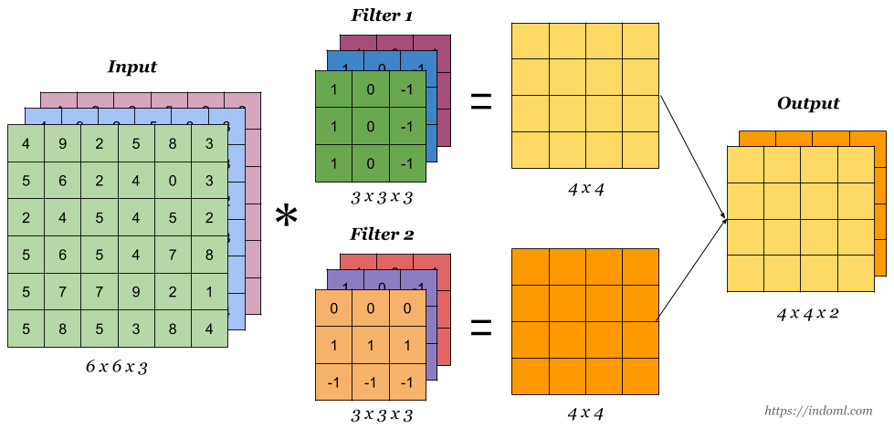
CNN 3 Channel

Slide 20

Convolution Neural Network (CNN)

Slide 21

Arch

Slide 22
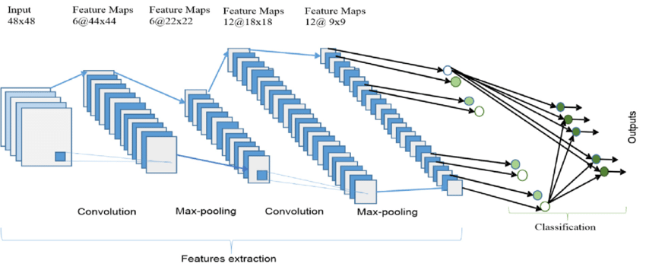
Arch

Slide 23
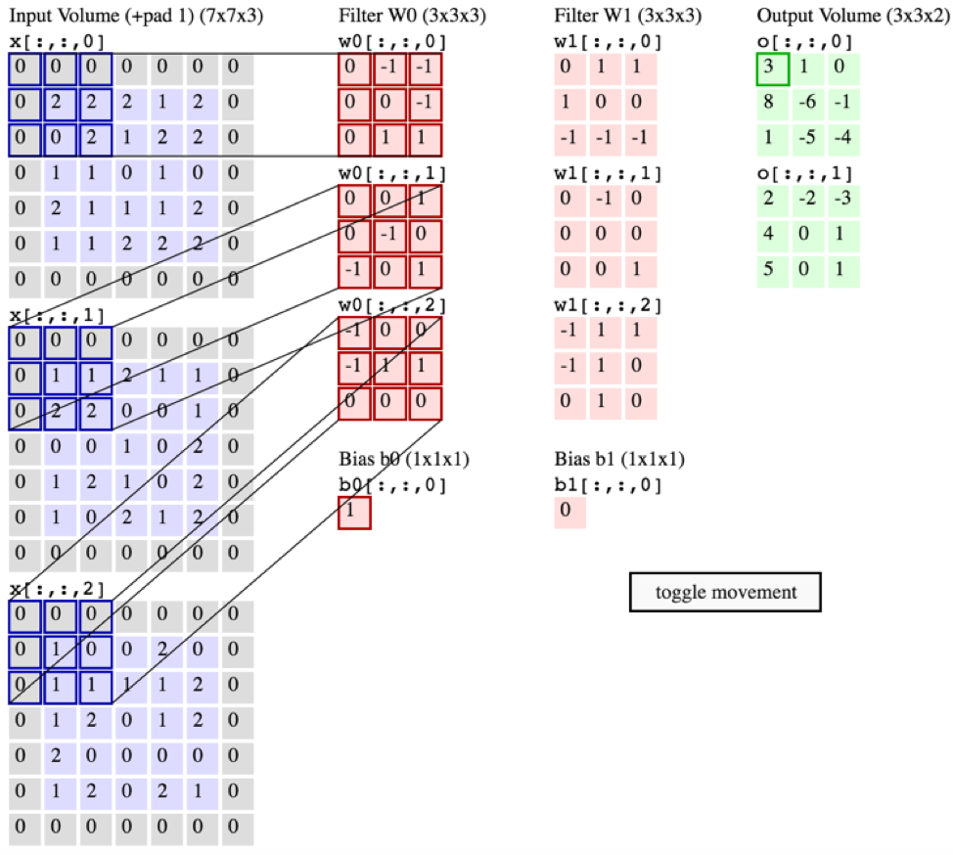
Difference Between Conv2D and Conv3D

Slide 24
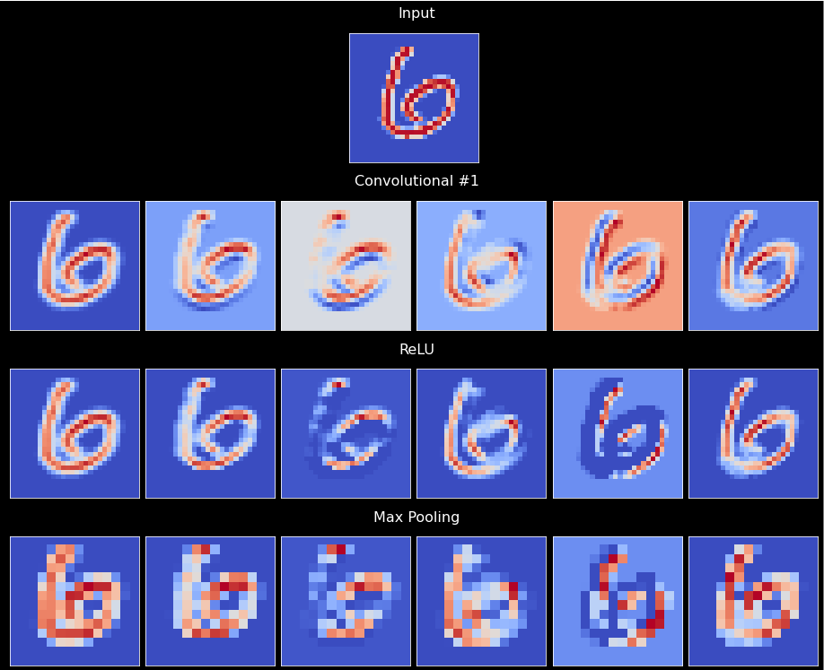
Abstraction of Feature Map

Slide 25
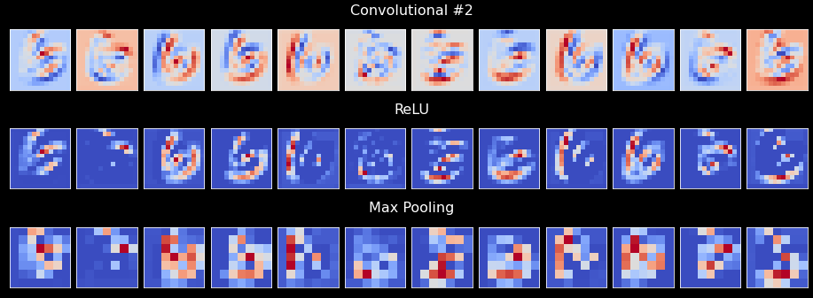
Abstraction of Feature Map

Slide 26
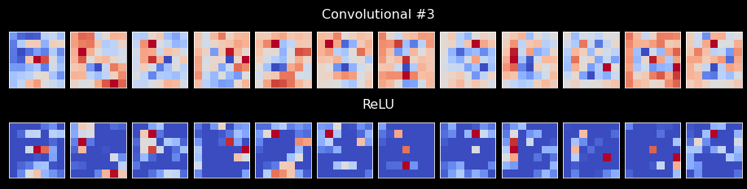
Abstraction of Feature Map

Slide 27
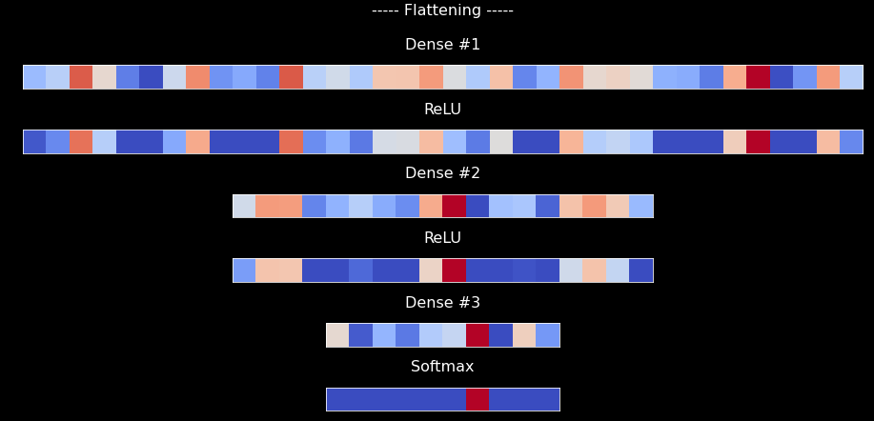
Abstraction of Feature Map

Slide 28
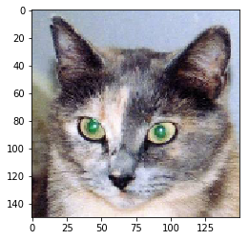
Abstraction of Feature Map

Slide 29
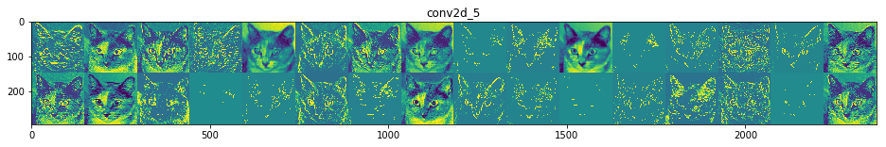
Abstraction of Feature Map
Layer 1

Slide 30
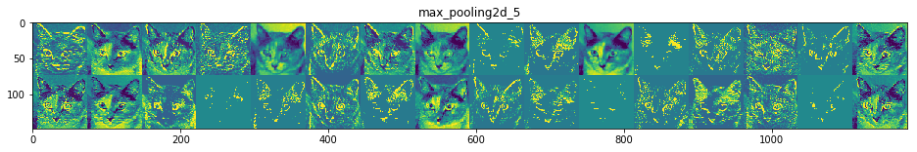
Abstraction of Feature Map

Slide 31
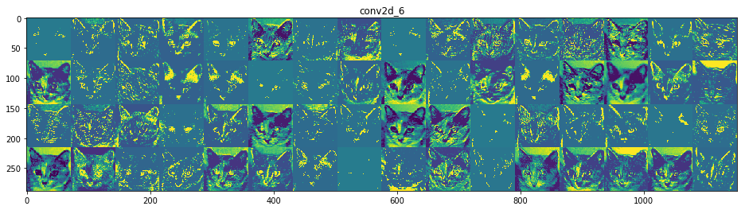
Abstraction of Feature Map

Slide 32
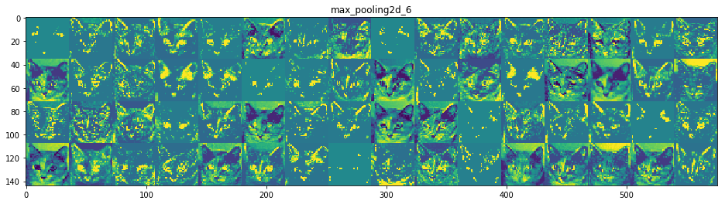
Abstraction of Feature Map

Slide 33
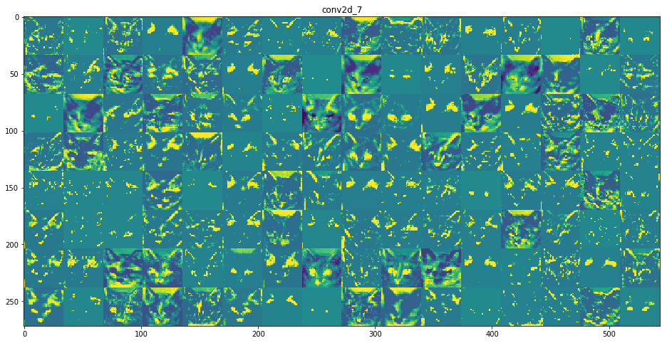
Abstraction of Feature Map

Slide 34
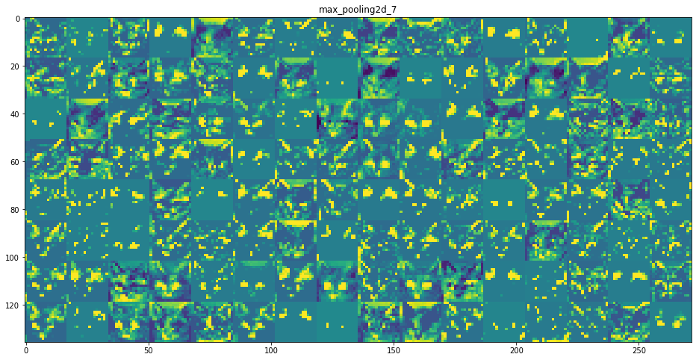
Abstraction of Feature Map

Slide 35
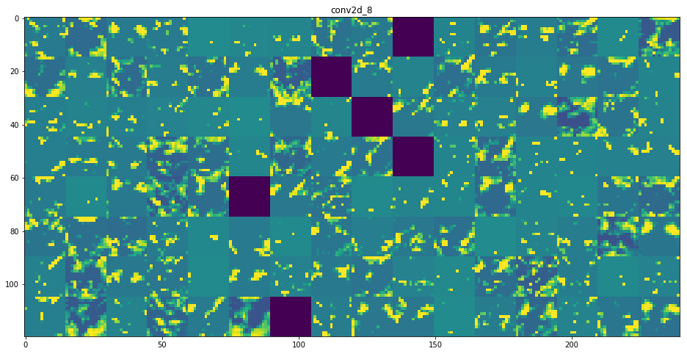
Abstraction of Feature Map

Slide 36
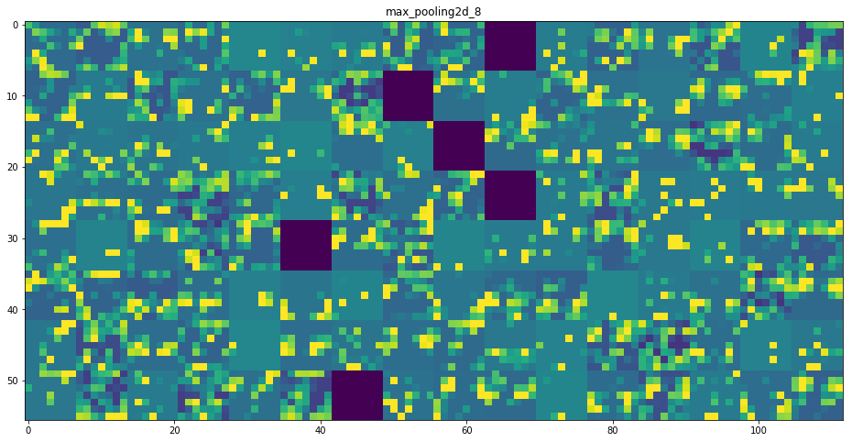
Abstraction of Feature Map

Slide 37
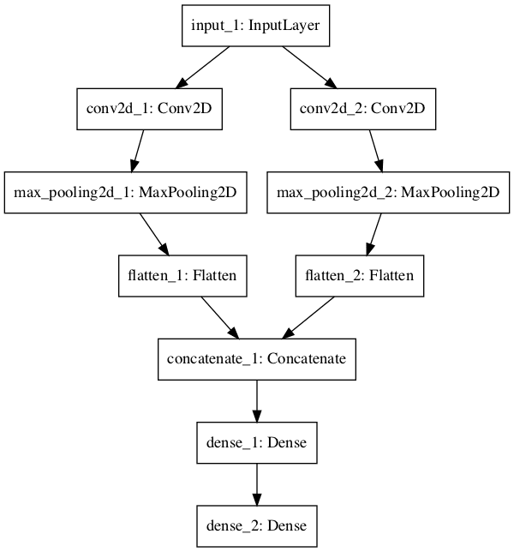
Functional Models

Slide 38
What is Gradient Vanishing?
More layers = More activation functions
Gradients of the loss function approaches zero

Slide 39
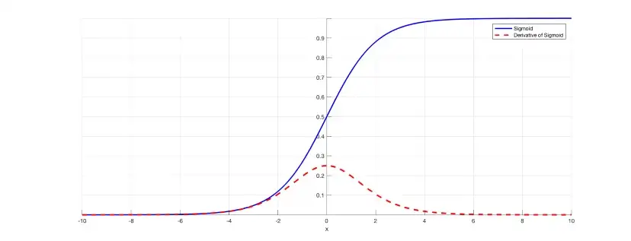
Why Gradient Vanish?

Slide 40
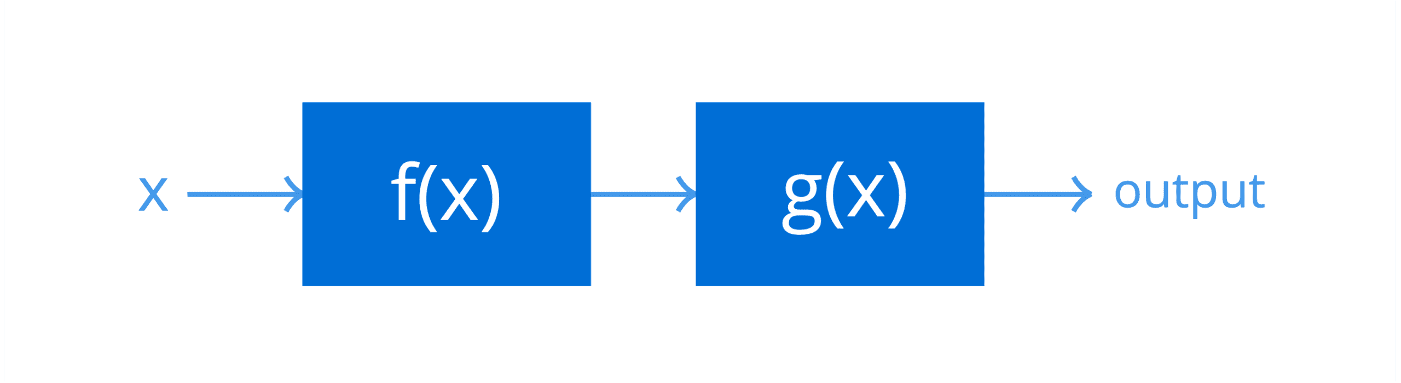
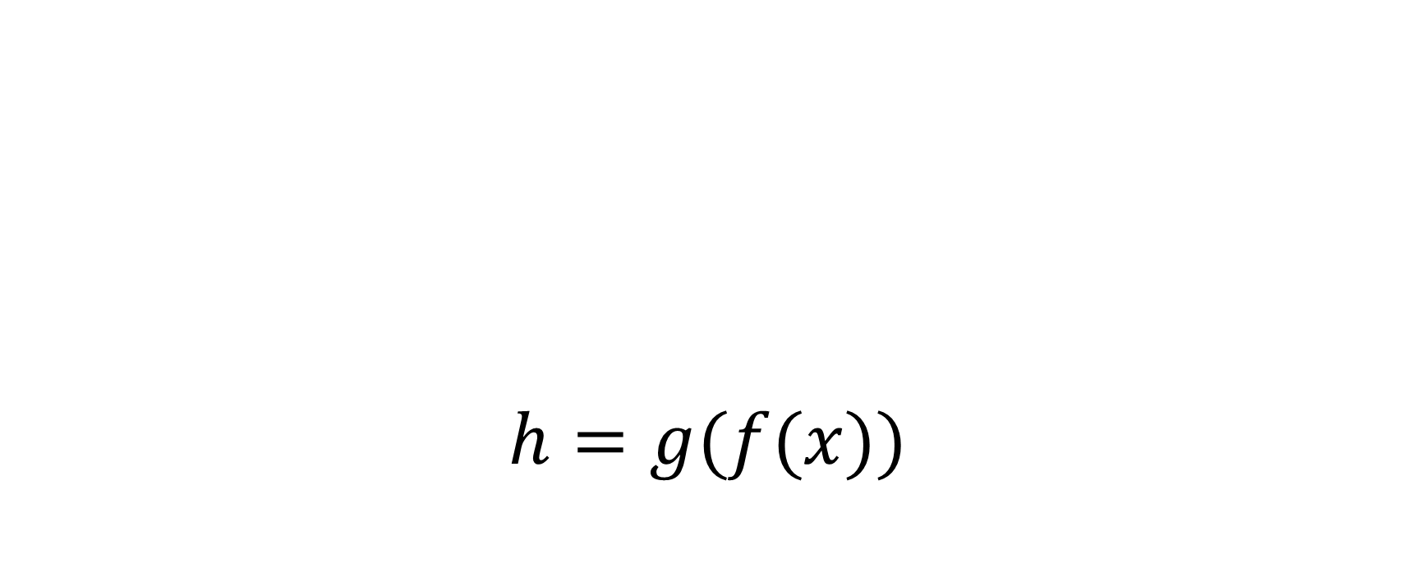
Chain Rule
$$h=g(f(x))$$

Slide 41
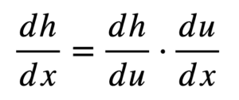
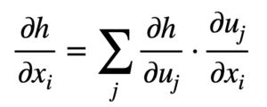
Chain Rule

Slide 42
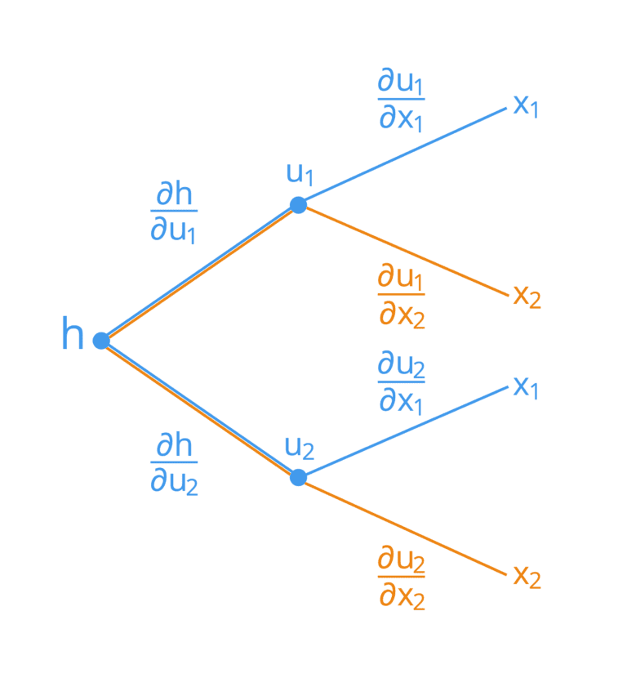
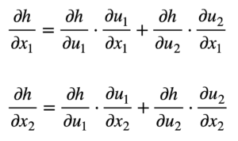
Chain Rule

Slide 43
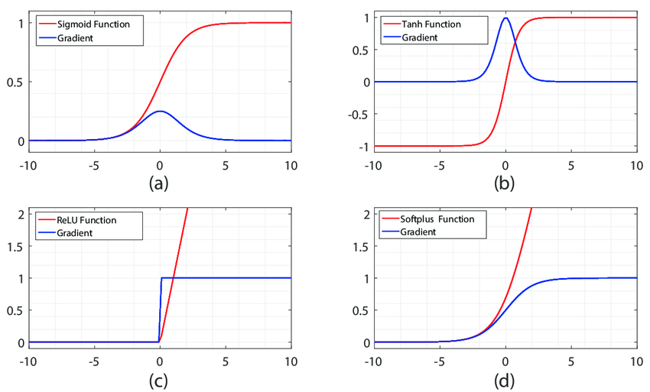
Activations Gradient

Slide 44
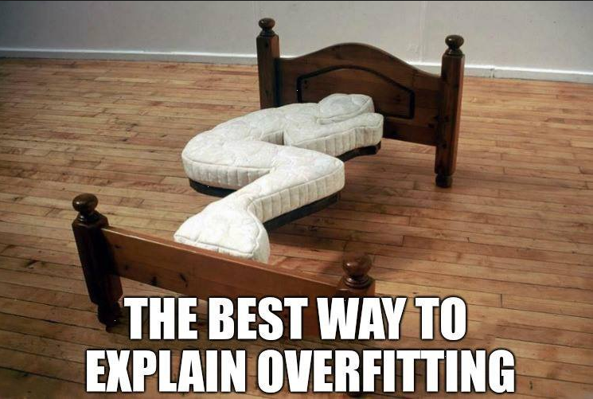
Overfitting - Underfitting

Slide 45
Reasons of Overfitting
Training data have:
Noise
Fluctuations
Neural network complexity

Slide 46
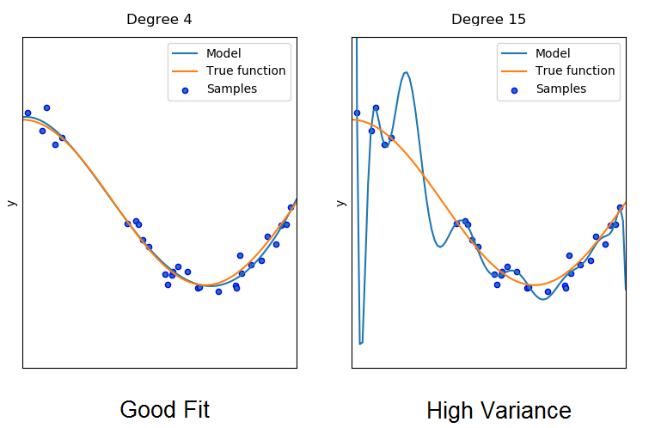
Neural Network Complexity (High)

Slide 47
Noise and Fluctuations
Model with high complexity is capable:
Pick up this random noise and fluctuations
Learn them as underlying concepts and patterns of the data

Slide 48
Underfitting
Model can not Learn:
Training data
Model also can not Predict!

Slide 49
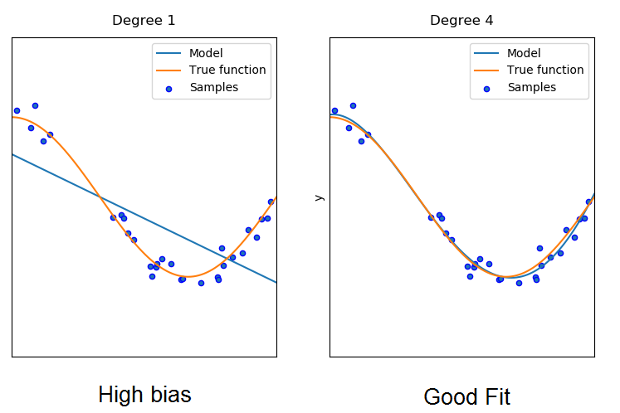
Neural Network Complexity (Low)

Slide 50
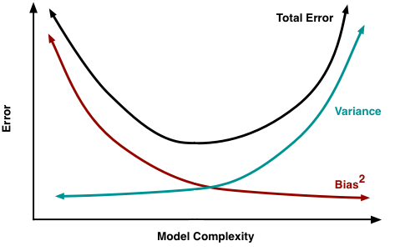
Variance Bias Tradeoff

Slide 51

How to Detect Overfitting

Slide 52
Identifying Overfitting and Underfitting during Training
The error/loss calculate periodically:
Training set
Validation set

Slide 53
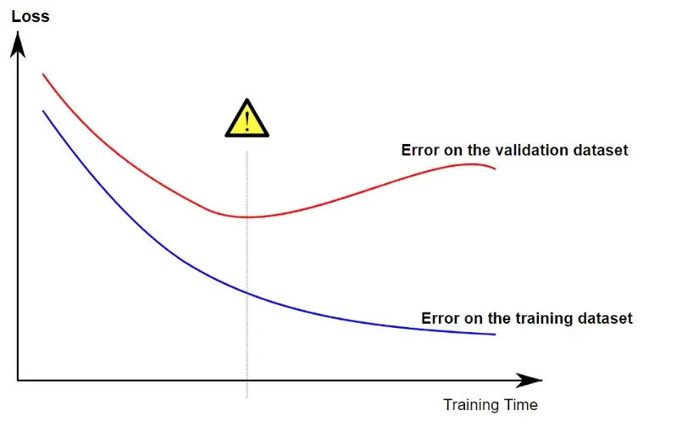
Identifying Overfitting and Underfitting during Training

Slide 54
How to Avoid Overfitting
Reduce the complexity:
Using fewer neurons or layers
Use regularization techniques

Slide 55
Regularization in Deep Learning
L1 Regularization
L2 Regularization
Dropout
Batch Normalization

Slide 56
What is Regularization
Set of techniques that:
lower the complexity of a neural network during training

Slide 57
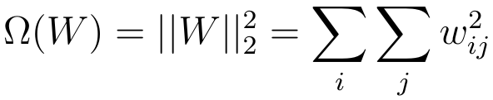
L2 Regularization
Known as:
Weight Decay
Ride Regression

Slide 58
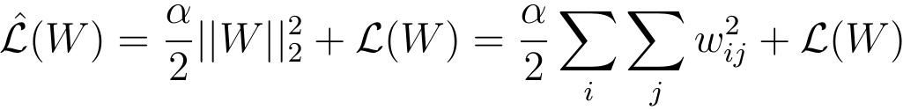
Where does Regularization Affect
Added to the regular loss function
Alpha called as the regularization rate

Slide 59
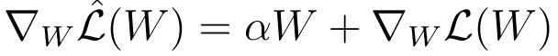
Where does Regularization Affect

Slide 60
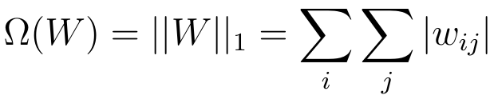
L1 Regularization
Known as:
Lasso Regression

Slide 61
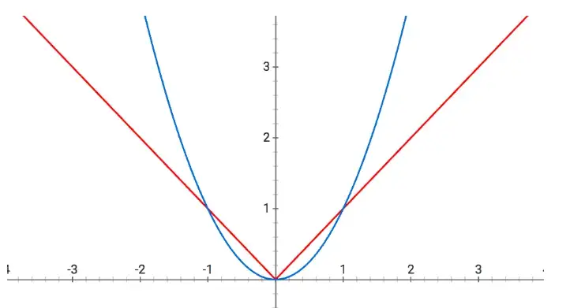
Why L1 and L2 Regularizations works

Slide 62
Why L1 and L2 Regularizations works
L2 regularization:
Our weight parameters decrease
But not necessarily become zero
L1 regularization:
Weight are always forced towards zero.
Smaller weights reduce the impact of the hidden neurons.
The overall complexity of the neural network gets reduced.

Slide 63
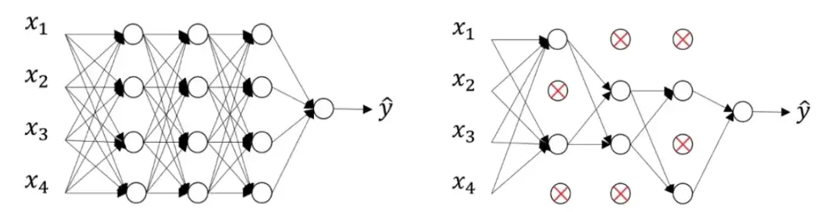
Dropout

Slide 64
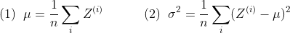

Batch Normalization

Slide 65

Batch Normalization

Slide 66
Where Use Batch Normalization
After the activation function:
For s-shaped functions:
Sigmoid
tanh
before the activation function:
For activations in non-Gaussian distributions:
Linear
Relu

Slide 67

Residual networks

Slide 68

AlexNet

Slide 69

AlexNet

Slide 70

VGG16

Slide 71


Slide 72

VGG19

Slide 73

ResNet

Slide 74

GoogLeNet (Inception)

Slide 75

Inception

Slide 76

Inception Module

Slide 77

YOLO

Slide 78

IoU

Slide 79
Data Augmentations
Geometric transformations (flip, crop, rotate, …)
Color space transformations (change RGB color channels)
Kernel filter (sharpen, blur, …)
Random Erasing
Noise injection

Slide 80

Data Augmentations

Slide 81

Data Augmentations

Slide 82

Transfer Learning

Slide 83
Transfer Learning Usage
Training a model to reuse it
Using a pre-Trained model
Feature extraction

Slide 84

Why does Transfer Learning Work?

